Slide 1

AUTOMOTIVE DATA PIPELINE:
28 November 2025
INGESTION,
TRANSFORMATION,
AND ANALYSIS USING DATABRICKS
Overview
This document overviews a data pipeline that processes automotive datasets from NHTSA, AFDC, and EPA using Databricks and the Medallion architecture. Gold-layer datasets and dashboards provide actionable insights for vehicle safety, infrastructure planning, and sustainability, using a reliable hybrid of manual and automated processing.
Daniel Emilian Miat
Notes:
---

Slide 2
Project Overview and Objectives
Notes:
Title & Overview of the Pipeline

Slide 3

Title & Overview of the Pipeline
Data Sources Integration
The pipeline integrates vehicle complaints, alternative fuel stations, and fuel economy data from public sources.
Medallion Architecture Layers
Data is organized into Bronze, Silver, and Gold layers to ensure quality, scalability, and auditability.
Pipeline Design and Tools
Combines manual ingestion and automated processing using Databricks, Python, SQL, and Delta Lake.
Transparency and Reproducibility
GitHub repository provides scripts, data samples, and dashboards to ensure transparency and reproducibility.
Notes:
The automotive data pipeline project focuses on ingesting, transforming, and analyzing datasets from three major public sources: NHTSA (vehicle complaints), AFDC (alternative fuel stations), and EPA (vehicle fuel economy). The pipeline leverages Databricks and the Medallion architecture, which organizes data into Bronze (raw), Silver (cleansed), and Gold (aggregated) layers. This structured approach ensures scalability, data quality, and auditability. The primary objective is to create a robust system that supports actionable insights for vehicle safety, infrastructure planning, and sustainability. The pipeline design emphasizes reliability and flexibility, combining manual ingestion for quality control with automated processing for efficiency. By using Databricks, the solution benefits from native support for Python and SQL, Delta Lake for ACID-compliant storage, and integrated scheduling capabilities. The GitHub repository linked in the documentation provides all scripts, processed data samples, and dashboards, ensuring transparency and reproducibility. This overview sets the stage for understanding the technical decisions, automation strategies, and challenges addressed throughout the project.

Slide 4
Scripts and Execution
Notes:
Explanation of Scripts, How to Run Scripts

Slide 5

Explanation of Scripts
Modular Script Organization
Scripts are organized by dataset folders, enabling easy navigation and reuse within the GitHub repository.
databricks_project/Data Engineering Assessment/U.S at Main_branch · miatdaniel/databricks_project
Data Pipeline Workflow
Workflows include ingestion, cleaning, transformation, and loading with detailed steps documented in notebooks.
Best Practices Implementation
Scripts enforce schema definitions, normalize columns, and handle null values using safe defaults for consistency.
Clear Documentation
Databricks notebooks include detailed Markdown comments explaining every step for user understanding and replication.
Notes:
The project includes multiple scripts organized by data source within a GitHub repository. Each folder corresponds to a dataset—NHTSA, AFDC, or EPA—and contains Databricks notebooks with detailed Markdown comments explaining every step. These scripts cover ingestion, cleaning, transformation, and loading processes. For example, the NHTSA pipeline begins by downloading ZIP files, extracting contents, and reading raw text files into Spark DataFrames. It then applies schema definitions, adds timestamps for lineage, and writes data to Bronze Delta tables. Similar structured workflows exist for AFDC and EPA datasets, ensuring consistency across sources. The scripts also implement best practices such as schema enforcement, normalization of column names, and handling of null values using safe defaults. By organizing scripts in a modular fashion, the repository facilitates easy navigation and reuse. Each notebook is designed for clarity, enabling users to understand the logic behind transformations and replicate the process in their own environments.

Slide 6

How to Run Scripts
Sequential Notebook Execution
Users run notebooks in order following the Medallion architecture: Bronze, Silver, then Gold layers.
Bronze Layer Data Ingestion
Bronze scripts handle raw data ingestion including file downloads, extraction, and loading to Delta tables.
Silver Layer Data Transformation
Silver layer scripts clean and standardize data by trimming whitespace, normalizing, and converting types.
Gold Layer Data Finalization
Gold layer scripts enforce schema, cast fields, and optimize datasets for analytics and reporting.
Notes:
Running the scripts involves using Databricks notebooks within the platform’s interactive environment. Users should execute the notebooks sequentially, following the Medallion architecture flow: Bronze → Silver → Gold. The Bronze layer scripts handle raw ingestion, including downloading files, extracting archives, and loading data into Delta tables. Silver layer scripts focus on cleaning and standardizing data, applying transformations such as trimming whitespace, normalizing strings, and converting data types. Gold layer scripts finalize the dataset for analytics by enforcing schemas, casting fields, and optimizing for reporting. Each notebook includes Markdown cells that provide context and instructions, making execution straightforward. Users can trigger these notebooks manually or schedule them using Databricks Jobs for automation. Before running, ensure that the required storage paths (e.g., /mnt/datalake) are configured and that permissions are set correctly. This structured execution strategy guarantees reproducibility and maintains data integrity throughout the pipeline.

Slide 7
Data Processing and Transformation Decisions
Notes:
Data Processing Decisions, Data Transformation Decisions

Slide 8

Data Processing Decisions
Data Cleaning and Normalization
Whitespace trimming and string normalization remove inconsistencies to improve join and aggregation accuracy.
Null Value Handling
Type-appropriate default values replace nulls, preserving column integrity without losing data fields.
Duplicate Detection
Unique identifiers like CMPLID help detect and remove duplicates, ensuring data record distinctness.
Repartitioning for Performance
Repartitioning optimizes file sizes and enhances read/write operations for better system performance.
Notes:
Data processing decisions were critical to ensuring data quality and usability. The pipeline implements trimming of whitespace and normalization of string fields to eliminate inconsistencies that could affect joins and aggregations. Null values are handled using type-appropriate defaults: strings are replaced with 'UNKNOWN,' integers with -1, floats with -1.0, and booleans with False. This approach preserves column integrity without dropping potentially valuable fields. Duplicate detection is performed using unique identifiers such as CMPLID for NHTSA complaints, ensuring that records remain distinct. Repartitioning strategies are applied to optimize file sizes and improve performance during read/write operations. These decisions collectively enhance the reliability of the Silver layer, creating a standardized dataset ready for transformation and analysis. By prioritizing data completeness and consistency, the pipeline supports downstream analytics and machine learning tasks without encountering schema or quality issues.

Slide 9

Data Transformation Decisions
Schema Enforcement
Strict schema enforcement ensures data compatibility with BI tools and analytics platforms for consistent reporting.
Data Standardization
Standardizing categorical and numeric fields maintains uniformity and accuracy across dashboards and calculations.
Data Cleaning and Optimization
Removing null or unknown columns and normalizing boolean fields improves data clarity and logical query operations.
Geospatial Data Precision
Casting latitude and longitude to precise decimal formats enhances accuracy for geospatial analysis.
Notes:
Transformation decisions focused on creating analysis-ready datasets in the Gold layer. Key steps included applying strict schema enforcement to ensure compatibility with BI tools and analytics platforms. Categorical fields were standardized to maintain uniformity across dashboards, while numeric fields were cast to appropriate types for accurate calculations. Date and timestamp fields were parsed using consistent formats, enabling time-based queries and trend analysis. Columns containing only null or 'Unknown' values were dropped to reduce noise and improve clarity. For geospatial data in the AFDC dataset, latitude and longitude were cast to Decimal(9,6) for precision. Boolean fields were normalized to true/false values, supporting logical operations in queries. These transformations not only improved data quality but also optimized the structure for reporting and visualization. By implementing these decisions, the pipeline delivers clean, reliable datasets that empower stakeholders to derive actionable insights efficiently.

Slide 10
Data Loading and Automation
Notes:
Data Loading Process, Automation Strategy

Slide 11

Data Loading Process
ACID-Compliant Storage
Delta Lake provides ACID-compliant storage ensuring data consistency and reliability during processing and updates.
Layered Delta Tables
Data is organized into Bronze, Silver, and Gold Delta tables for structured processing and optimized querying.
Time Travel Feature
Delta Lake supports time travel, enabling access to historical data versions for auditing and rollback purposes.
Integration with BI Tools
Registered Delta tables in the metastore allow SQL access and seamless integration with business intelligence tools.
Notes:
The data loading process leverages Delta Lake within Databricks to provide ACID-compliant storage and schema evolution capabilities. After processing, datasets are written to Bronze, Silver, and Gold Delta tables stored in DBFS paths such as /mnt/datalake. Each table is registered in the Databricks metastore, enabling SQL access and integration with BI tools. This structured approach ensures that data remains consistent and queryable across layers. The use of Delta Lake also supports time travel, allowing users to access historical versions of data for auditing or rollback purposes. By organizing data into distinct layers, the pipeline facilitates incremental updates and efficient resource utilization. This design aligns with modern data engineering best practices, providing a robust foundation for analytics and reporting.

Slide 12

Automation Strategy
Manual Data Ingestion
Manual ingestion downloads and validates source data to mitigate API downtime and corrupted files risks.
Automated Data Processing
Automated workflows using Databricks Jobs transform data through Bronze, Silver, and Gold layers efficiently.
Scheduling and Monitoring
Scheduling triggers pipelines on a fixed cadence or new file arrivals while monitoring ensures error detection.
Hybrid Automation Benefits
Combining manual and automated steps balances control and scalability for a resilient data pipeline.
Notes:
The automation strategy combines manual and automated steps to balance reliability and efficiency. Manual ingestion is employed for downloading and validating source data from public APIs, mitigating risks associated with API downtime, rate limits, and corrupted files. Once data is uploaded to cloud storage or DBFS, automated workflows take over using Databricks Jobs or Delta Live Tables. These jobs handle transformations across Bronze, Silver, and Gold layers, applying cleaning, enrichment, and aggregation logic. Scheduling ensures pipelines run on a fixed cadence or trigger upon new file arrivals. Monitoring and alerting mechanisms are integrated to detect errors and maintain operational continuity. This hybrid approach provides control over external dependencies while leveraging automation for internal processes, resulting in a scalable and resilient pipeline.

Slide 13
Challenges and Solutions
Notes:
Challenges Faced, Solutions Implemented

Slide 14
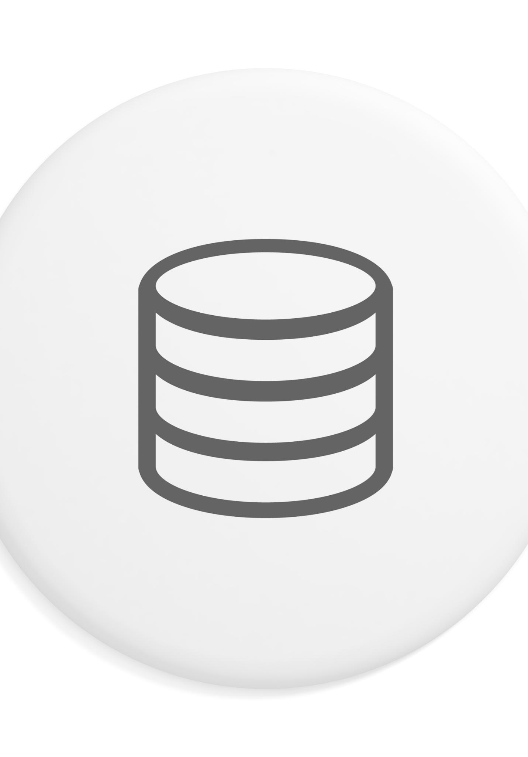
Challenges Faced
API Ingestion Issues
API ingestion faced timeouts and network errors causing unreliable data flow and integration difficulties with Spark.
Large File Processing
Handling large ZIP files caused memory constraints and inefficiencies in processing data pipelines.
Null Value Handling
Managing null values without dropping columns preserved important data but added processing complexity.
Schema Consistency Challenges
Ensuring consistent schema across diverse and evolving datasets was complex due to format inconsistencies.
Notes:
Several challenges emerged during the project. API ingestion proved unreliable due to timeouts, network errors, and service instability, making direct integration with Spark problematic. Large initial ZIP files posed memory constraints and were difficult to process efficiently. Handling null values without dropping columns was another significant challenge, as columns might still hold analytical value despite missing data. These issues required careful consideration to prevent pipeline failures and maintain data integrity. Additionally, ensuring schema consistency across diverse datasets introduced complexity, particularly when dealing with evolving data structures and inconsistent formats from public sources.

Slide 15

Solutions Implemented
Controlled Data Ingestion
Manual downloads and uploads to DBFS ensured a stable and controlled data ingestion process despite API instability.
Efficient ZIP File Handling
Chunk-based streaming and Python’s zipfile module reduced memory usage and prevented crashes when processing large ZIP files.
Dataset Splitting with PowerQuery
Oversized datasets were split into manageable parts using PowerQuery to facilitate smooth ingestion and processing.
Handling Null Values
Null values were replaced with type-appropriate defaults, ensuring data completeness without compromising analysis quality.
Notes:
To address these challenges, the team implemented several solutions. For API instability, manual downloads followed by uploads to DBFS provided a controlled ingestion process. Large ZIP files were handled using chunk-based streaming and Python’s zipfile module, reducing memory usage and preventing crashes. PowerQuery was used to split oversized datasets into manageable parts for ingestion. Null values were replaced with type-appropriate defaults—such as 'UNKNOWN' for strings and -1 for numeric fields—ensuring completeness without sacrificing analytical potential. These strategies collectively enhanced pipeline reliability, data quality, and operational efficiency, enabling successful execution of the project objectives.

Slide 16
Insights and Dashboards
Notes:
Final Insights & Dashboards

Slide 17

Final Insights & Dashboards
NHTSA Data Insights
Dashboards reveal manufacturer complaints, failing components, and trends to aid quality improvement and recall planning.
AFDC Infrastructure Analysis
Dashboards analyze station coverage, access types, and incomplete records to support infrastructure and data quality planning.
EPA Sustainability Metrics
Dashboards present fuel efficiency, annual fuel costs, and CO2 emissions data to inform sustainability and fleet management.
Notes:
The Gold-layer datasets served as the foundation for dashboards that deliver actionable insights. For NHTSA data, dashboards highlight complaints by manufacturer, top failing components, and trends over time, guiding quality improvement and recall strategies. AFDC dashboards analyze station coverage by state, access type distribution, and incomplete records, supporting infrastructure planning and data quality initiatives. EPA dashboards focus on fuel efficiency by model, average annual fuel costs by vehicle class, and CO2 emissions by manufacturer, informing sustainability and fleet management decisions. These visualizations enable stakeholders to make informed, data-driven decisions that enhance safety, efficiency, and environmental performance across the automotive industry.

